Slide 1
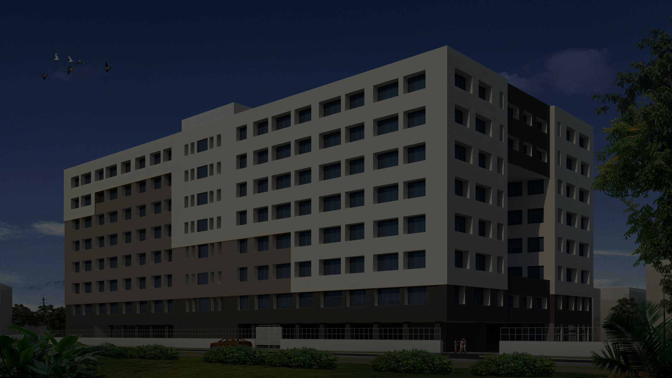
8th International Conference on Advances in Energy Research
7-9 July 2022

Slide 2
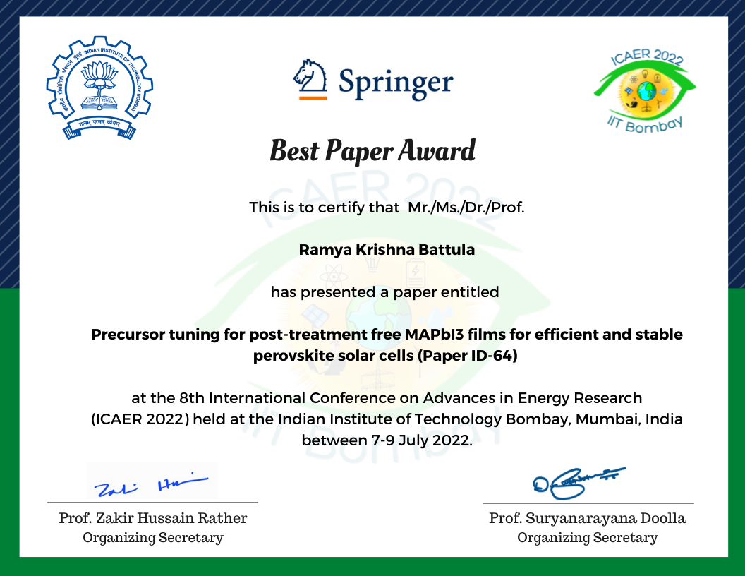

Slide 3
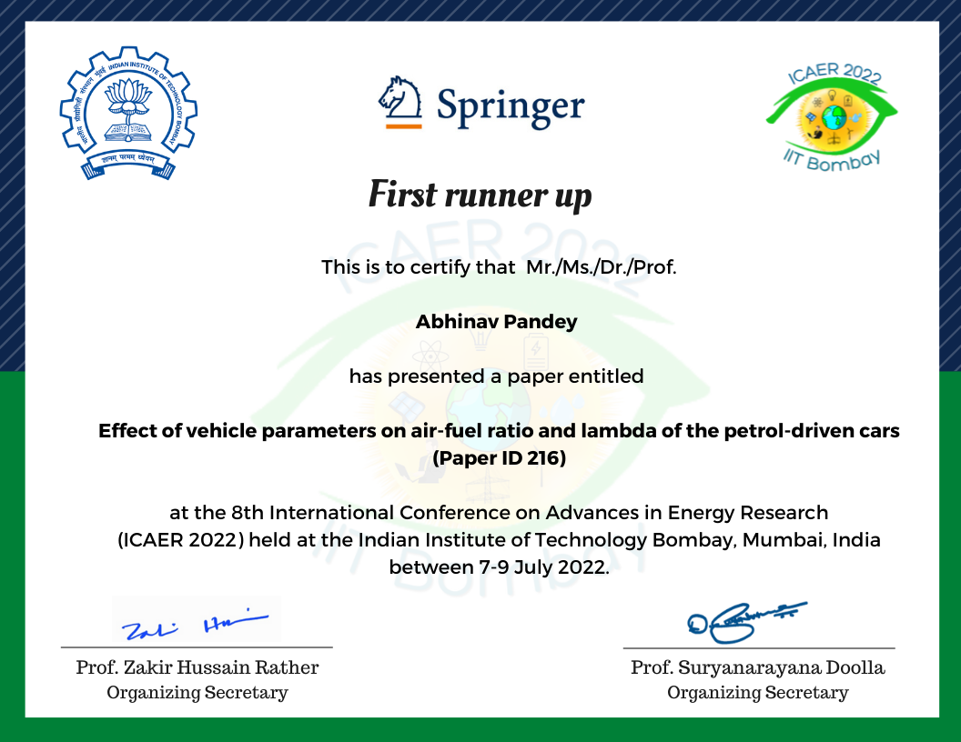

Slide 4
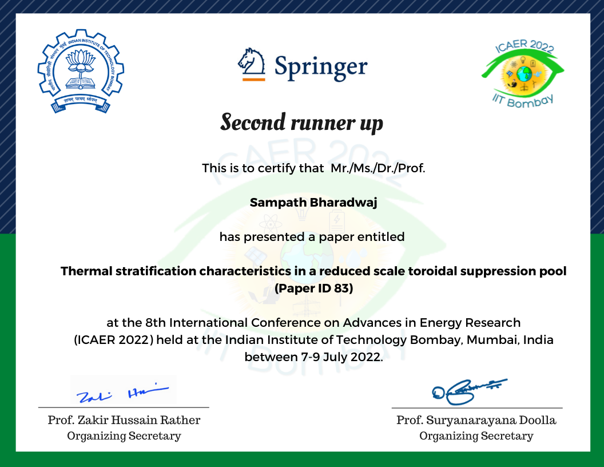

Slide 5
Consolation prizes
Sr. No. | Author(s) | Paper ID | Paper Title
1 | Ashish Sharma | 107 | Potential Assessment For Repowering Of Solar Projects In India
2 | Sreeraj R | 184 | Heat Transfer Enhancement Of Metal Hydride Based Hydrogen Storage Device Using Nano-fluids
3 | Jani Das | 4 | Clear Sky And Real Sky Solar Radiation Modelling For Locations In India
4 | Srinath Haran | 154 | Comparison Of Different Types Of Coal Powerplants In India Retrofitted With Calcium Looping Based CCS System
5 | Mugala Naveen Kumar | 179 | After Lifetime Reliability And Performance Analysis Of PV Modules
6 | Sumana Dey | 79 | Study Of Induction Heating In Minimizing Cold Start Emissions In Catalytic Converter
7 | Ankit Gandhi | 183 | Optimization Of Circulation Power In First Wall Of Breeding Blanket Using He-co2 Gas Mixture As A Replacement Of Helium

Slide 6
Thank You

